Slide 1
Project Progress Report
DOT Traffic Ops database migration project
Jason Wu, Hyun Soo Lee

Slide 2
Background, Goals, Objectives
Background: The current database that NYC DOT Traffic Ops is using to store relevant information on crossing signals is slow to respond to input, takes up excessive and redundant storage, is user unfriendly, and requires dedicated maintenance.
This project intends to resolve this problem by creating a new database and User Interface that will replace the existing database and UI and port over all existing data.

Slide 3
Updates
We have received a copy of the database from Bill. We are currently working

Slide 4
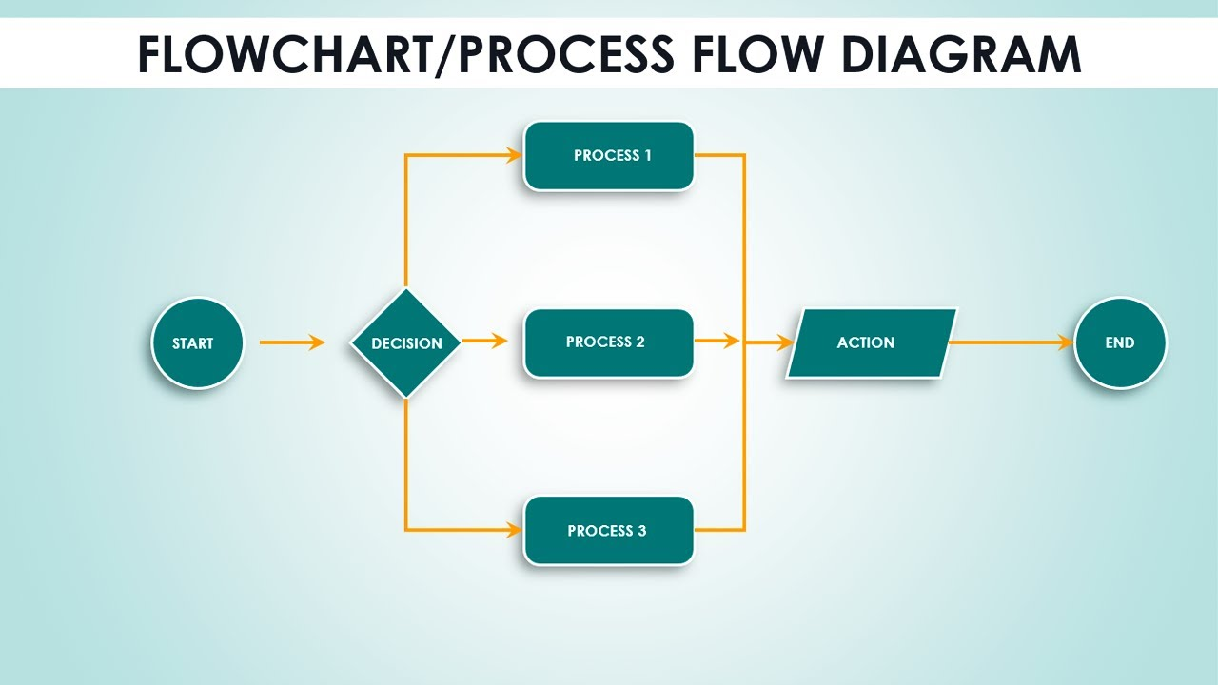
Process diagram

Slide 5
Schedule for Workflow diagram
Planning
Execution
Monitoring

Slide 6
Communication Plan
Add one or two tables (see Lesson 5)

Slide 7
Screen shots

Slide 8
Demonstration

Slide 9
Schedule for next steps

Slide 10
Questions?
Thank You!
Contact Info:

